Slide 1


W1 CONTINUED & FORMING A WINNING TEAM
WEEK 2

Slide 2
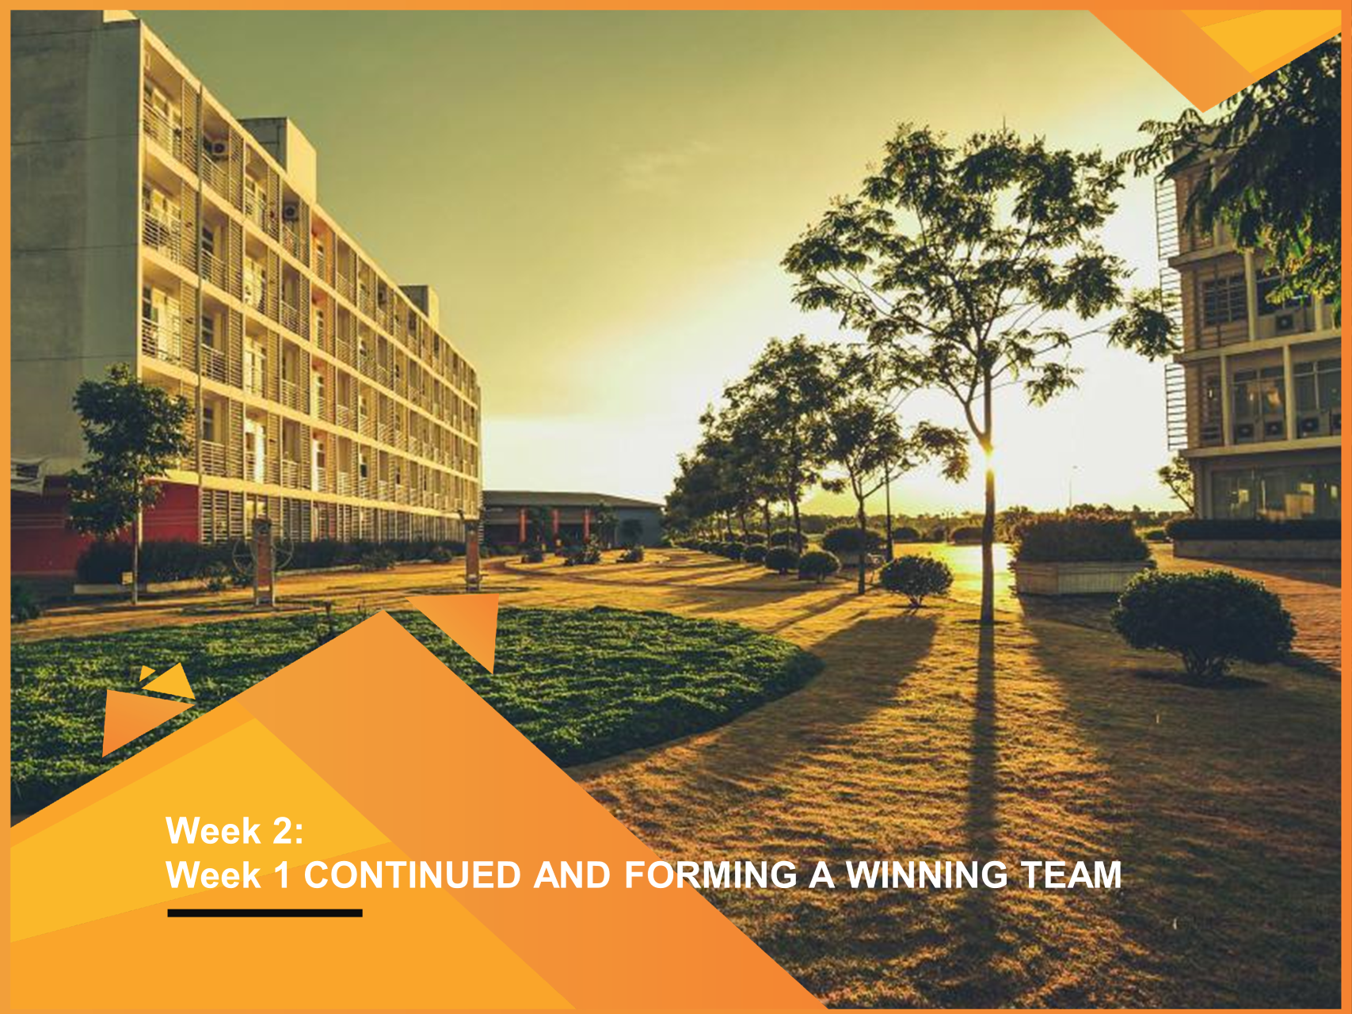
W1 CONTINUED & FORMING A WINNING TEAM
WEEK 2

Slide 3
LEARNING OBJECTIVES FOR W1 & W2
LO1: Understand the the concept of entrepreneurship and its classification
LO2: Startups definition and successful case studies
LO3: School of thought about entrepreneurship
LO4: The dark side of entrepreneurship
LO5: Forming a winning team

Slide 4
WHAT IS RISK
TO BE CONTINUED FROM WEEK 1

Slide 5
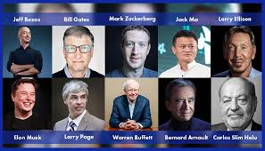
MICRO SCHOOLS OF THOUGHT (CONT)
Entrepreneurs vary in:
Gender
Age of starting business
Race
Personality
…..
Yet, what kinds of psychological characteristics/processes that set these groups of people apart?

Slide 6
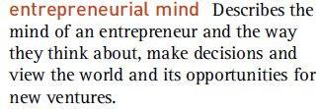
MICRO SCHOOLS OF THOUGHT (CONT)
ENTREPRENEURIAL MIND
What is/happens inside the mind of an entrepreneur?
What motivates them to become an entrepreneur?
How do they think (differently)?
What do they see (differently)?
What are the most common characteristics associated with successful entrepreneurs?
=> Examining the entrepreneurial mind provides an interesting look at the entrepreneurial potential within every individual
Source: Frederick et al., 2016

Slide 7

MICRO SCHOOLS OF THOUGHT (CONT)
ENTREPRENEURIAL MOTIVATION
Why would someone take on the stress and effort of launching a new business, unsure of its success, risking their finances, and mental well-being, and even jeopardizing their relationships and personal life?
Source: Frederick et al., 2016

Slide 8
MICRO SCHOOLS OF THOUGHT (CONT)
ENTREPRENEURIAL MOTIVATION
Motivation can be simply defined as the driving forces that encourage individuals to initiate and sustain actions and efforts toward a desired end goal.
Motivation to initiate an action (e.g., start exercising)
Motivation to sustain action (e.g., keep exercising regularly)
Source: Frederick et al., 2016

Slide 9
MICRO SCHOOLS OF THOUGHT (CONT)
ENTREPRENEURIAL MOTIVATION
Pull factors (Opportunity driven) | Push factors (Necessity driven)
Positive aspects or incentives that attract individuals towards entrepreneurship. | Negative circumstances, challenges, or pressures that push individuals towards entrepreneurship.
Source: Frederick et al., 2016

Slide 10
MICRO SCHOOLS OF THOUGHT (CONT)
ENTREPRENEURIAL MOTIVATION
Pull factors | Push factors
Autonomy and Independence Achievement and Recognition Personal development and Self-fulfillment Personal wealth Identify a market opportunity | Unemployment Job insecurity Job dissatisfaction Lack of career prospects Does not “fit in” No other alternatives
Source: Frederick et al., 2016

Slide 11
MICRO SCHOOLS OF THOUGHT (CONT.)
Entrepreneurial mindset: identify and seize opportunities, innovate and solve problems, and build successful ventures.
SKILLS
(problem-solving, critical thinking, communication, etc)
Beliefs
(growth mindset, value of failure…)
Characteristics
(Calculated risk-taking, creativity, resilience, etc)
Source: Frederick et al., 2016

Slide 12
MICRO SCHOOLS OF THOUGHT (CONT.)
ENTREPRENEURIAL SKILLS
Entrepreneurial skills refer to the specific abilities and competencies that individuals develop to effectively navigate the process of starting and managing a business venture.
Entrepreneurial skills are learned and honed through education, training, and experience, and they are directly applicable to the tasks and responsibilities involved in entrepreneurship.
Hard skills: financial literacy, marketing & sales, technical skills, etc
Soft skills: communication, leadership, problem-solving, negotiation, time management, etc
Source: Frederick et al., 2016

Slide 13
REFERENCES VIDEOS
- Jack Ma - "We never give up."
(Jack Ma failure)
How KFC's Colonel Sanders Failed 1009 Times and Became Successful In His 60s - Motivational Video
(KFC motivation)

Slide 14

How could entrepreneurship be seen as RISKY?

Slide 15
WHAT IS RISK?
Risk: the possible variation in an outcome from what is expected to happen
Variability: events in the future cannot be predicted with certainty
Expectation: we expect something to happen, or perhaps hope that it will not happen
Outcomes: what actually happens compared with what is intended or expected to happen
It is important to note that risk is not necessarily a bad thing if it is managed appropriately/properly
Source: ICAEW, 2022

Slide 16






WHAT IS RISK
Financial risk – exposure to bankruptcy
Career risk – can’t go back to old job
Family and social risk – missing out
Psychic risk – psychological impact of failure

Slide 17
FORMING A WINNING TEAM

Slide 18



WHY DOES A START-UP NEED A CO-FOUNDER?
1) PRODUCTIVITY: more and better work done by having complementary skills and enjoying discussing ideas
2) MORAL SUPPORT: it's great to have someone you can lean on for support during the tough times
3) Co-founder: a pattern matching to success. Most successful startups like Apple, Facebook, Google, Microsoft, etc all had co-founders when they started.
Source: Y Combinator

Slide 19

WHAT CHARACTERISTICS DO CO-FOUNDERS HAVE?
Have a complementary set of skills to help grow the company.
Share the same vision
More importantly, working with someone that you like working with and sharing trust.
Source: Y Combinator

Slide 20

WHERE TO LOOK FOR CO-FOUNDER?
Start with people you already knew (ideally friends, and colleagues)
Smart coworkers in the same company/project
Meet people having the same interests
Source: Y Combinator

Slide 21
EQUITY SPLIT
50-50
Startups are a long-term game and you win by making the best decision long term.

Slide 22

HOW TO CONVINCE SOME ONE TO JOIN YOUR STARTUP
Convince yourself first 🡺 to show how committed you are to the idea.
Convinced by a startup idea 🡺 can’t sleep at night and can’t think of anything else.
If you are convinced then it’s much easier to convince others.
Source: Y Combinator

Slide 23
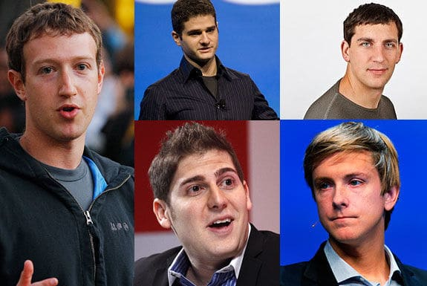
CASE STUDY: FACEBOOK
Facebook is a social networking service and was found by Mark Zuckerberg, Eduardo Saverin, Andrew McCollum, Dustin Moskovitz, and Chris Hughes.
The website's membership was initially limited by the founders to Harvard students, but was expanded to other colleges in the Boston area, the Ivy League, and gradually most universities in the United States and Canada, etc

Slide 24
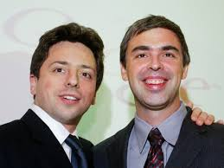
CASE STUDY: GOOGLE
Google was officially launched in 1998 by Larry Page and Sergey Brin, which has become the most used web-based search engine.
Google has its origins in "BackRub", a research project that was begun in 1996 by Larry Page and Sergey Brin when they were both PhD students at Stanford University in Stanford, California.

Slide 25
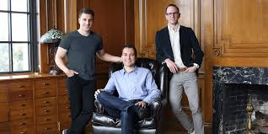
CASE STUDY: AIRBNB
Airbnb was founded in 2008 by Brian Chesky, Nathan Blecharczyk, and Joe Gebbia. It is the most well-known company for short-term housing rentals.
The idea was first raised in 2007 by Brian Chesky and Joe Gebbia who were roommates and former schoolmates. Later February 2008, Nathan Blecharczyk, Chesky's former roommate, joined as the chief technology officer and the third co-founder of the Airbnb

Slide 26
REFERENCES
a) How to Find the Right Co-founder (Link: https://www.ycombinator.com/library/8h-how-to-find-the-right-co-founder)
b) How to Work Together (Link: https://www.ycombinator.com/library/6n-how-to-work-together)
c) How to Find a Co-founder (Link: https://www.ycombinator.com/library/7j-how-to-find-a-co-founder)
d) How do You Convince Someone to Join Your Startup? (Link: https://www.ycombinator.com/library/5b-how-do-you-convince-someone-to-join-your-startup)
Frederick, H., O'connor, A., & Kuratko, D. F. (2016). Entrepreneurship: Theory, process, and practice. Cengage Learning.

Slide 27
KEY TAKEAWAYS FOR W2
KA1: To understand the micro school of thought about entrepreneurship, including entrepreneurial mind, motivation, and skills.
KA 2: To realize the dark side of entrepreneurship
KA 3: To be able to select suitable members and form a winning team

Slide 28



